Slide 1


CUsTOMER PERSONALITY ANALYSIS
USING TABLEAU
By Rajiv Puli
Under the guidance of Dr. Roger McHaney

Slide 2
What is customer personality analysis?
Customer Personality Analysis is a detailed analysis of a company’s ideal customers.
It helps a business to better understand its customers and makes it easier for them to modify products according to the specific needs, behaviors and concerns of different types of customers.
For example, instead of spending money to market a new product to every customer in the company’s database, a company can analyze which customer segment is most likely to buy the product and then market the product only on that particular segment.

Slide 3
Important questions to be answered
How does the income level of the customer impacts the amount he spends on buying the products?
What type of products do customers who are married spend their money on?
Does the age of customers has any effect on the kind of products they spend on?
What type of customers are the ones who are spending high amounts on buying wines?

Slide 4
How are the income levels and age is effecting the amount the customers spend on all products?
We can see that the 20-40 age range with an annual income of 60k are spending a high amount.
We can also see that the 40-60 age range customers with an annual income of 60k are spending much amount on buying the products.
From this we can understand that they are the ideal customers for the company.

Slide 6
Total amount spent by marital status
Irrespective of the marital status all the customer's much amount on wines.
Especially the married customers spent much amount on all kinds of products.
The amount spent on meat products is also high for all categories in marital status.
So, increasing the range of wines can maintain the ideal customers who buy wines.
Also, including offers for wines like a discount when customers buy in high amounts can further increase sales.
Married and together customers seem to be ideal customers.

Slide 8
Amount spent based on age
The age group of 20-40 are spending much amount on Wines.
The amount spent on meat is also high for the same age group.
For the age group 40-60 are also spending on wines and meat products.
These are the ideal groups of customers in age group.

Slide 10
Amount spent on wines by education
The customers who did graduation, are the highest consumers of wines.
Also, the customers who studied Ph.D. are heavy consumers of wines.

Slide 12
The amount spent by customers by year joined.
In 2012, 494 customers joined as a member of the supermarket in which they spent $368K.
In 2013, 1,189 customers joined as a member of the supermarket in which they spent $715K.
In 2014, 557 customers joined as a member of the supermarket in which they spent $273K.
From 2012, the amount spent got decreased until 2014. Which is not a good sign.
According to the insights the actions should be taken.

Slide 13
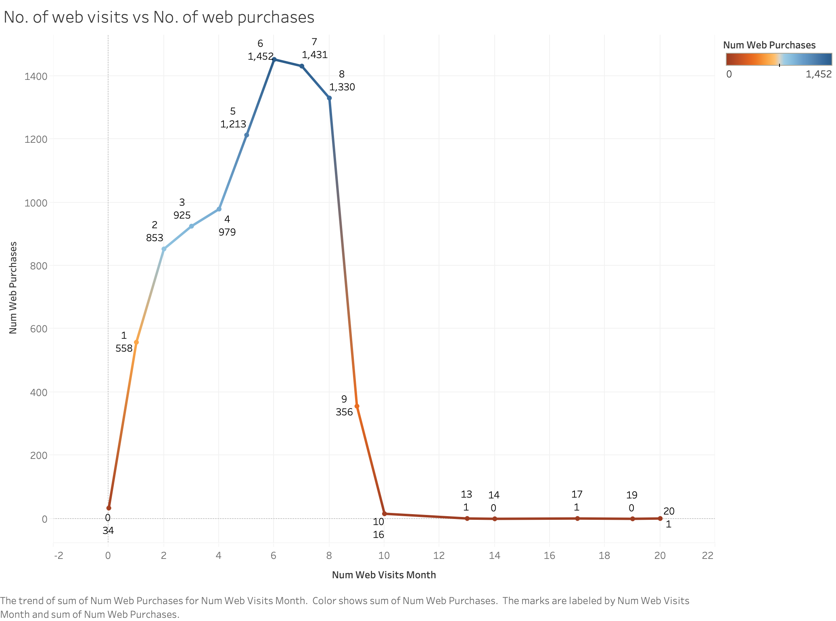

Slide 14
No. of web visits vs no. of web purchases
This analyzes how many times the customers are visiting the website and at what rate they are buying the products when they visit.
We can see that the customers who visited 6 times made a higher number of purchases.
It is good that the customers are buying in web sites when they visit.
But there is a decrease in purchases from the 9th visit. So, customers who are visiting more than 8 times are less likely to buy the products on the website.
We may interpret that they want to check the website to compare with the other competitors or they want to buy products only in-store.

Slide 15
•This is regarding the customers who accepted the marketing campaign of the company according to the income levels of the customer.
•More number of 80k annual income category customers accepted the campaigns.
•Also, the 60k annual income category customers accepted more number campaigns.
•The ideal group for marketing campaigns is 40-60k and 60-80k income range customers.

Slide 16
The amount spent on all products by the customers based on their annual income is displayed here.
The income group of $40-60K range spent the highest amount of $691k on the products.
The second highest in the $60-80K range customers who spent $316K on the products.
So, the income range of $40-60K and $60-80K are the ideal customers for the company.

Slide 18
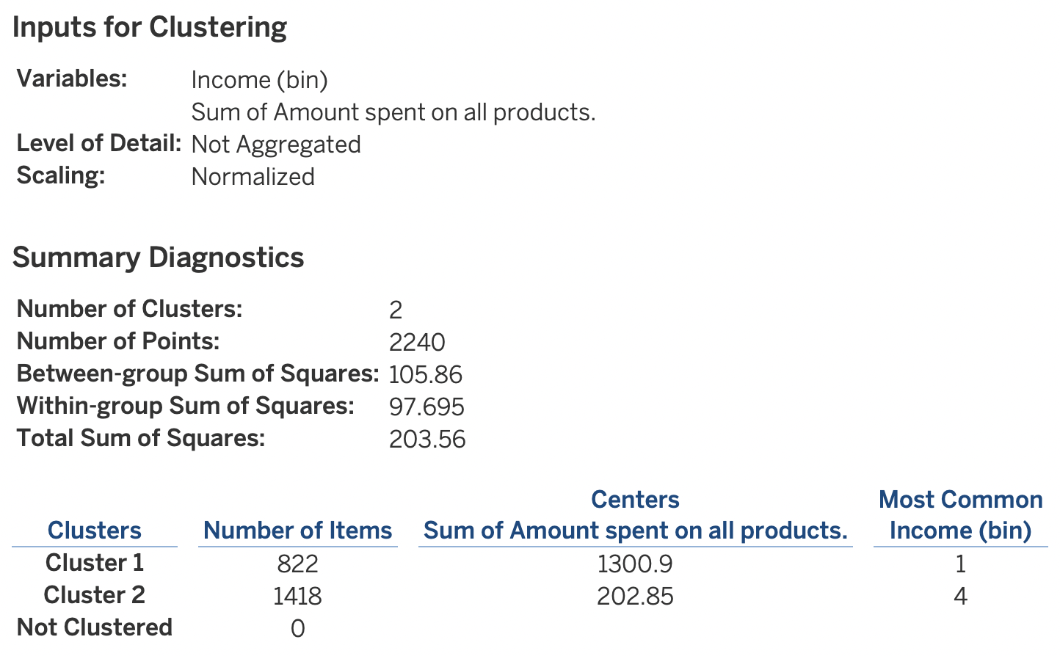
Clustering analysis
Clustering analysis is performed on basis of Income levels of the customers and the amount they spent on all the products.
The total number of points is 2240.
It is divided into two clusters in which cluster 1 is of size 822 and cluster 2 is of size 1418.
For cluster 1, the cluster center amount spent on all products is $1300, and the most common income bin is $20-40k.
For cluster 2, the cluster center amount spent on all products is $202, and the most common income bin is $80-100k.
So, cluster 1 consists of 36% of whole customers and they spend more amount on buying products whereas the cluster 2 consists of 63% and spend less amount on buying the products.

Slide 19
Conclusion
The ideal customers for the company attributes are:
The customer’s Income levels are $40-60k and $60-80k
The customer’s age group is 20-40 and 40-60 years.
In context to marital status the ideal customers are Married and Together.
The highest amount customers spend money is on Wine products and meat products.

